Slide 1


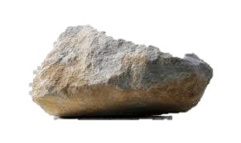
Capstone
2 June 2024

Slide 2
Table of contents
02
01
Work in progress
Problem Statement
03
Data

Slide 3
Problem Statement
Privacy Invasion – using other individual’s identity for fraud
Security Risks - personal information leaked
Financial Loss – credit card information exposed

Slide 4

Objectives
Classify it as spam or not spam
Build a real-time spam detection system that can analyze incoming SMS messages
Investigate which features are most important for accurately detecting spam messages (e.g., word frequency, message length, presence of certain keywords)

Slide 5
Data
Still cleaning … - Spam.csv https://www.kaggle.com/datasets/uciml/sms-spam-collection-dataset/data

Slide 6
Current progress …. My EDA
Message lengths
Bigrams between spam and non-spam messages
Repetitive words

Slide 7

Thanks
Do you have any questions?

